Slide 1
Machine learning refresher

Slide 2
Contents
Intro to Machine Learning
Types of Machine Learning
Machine Learning Pipelines
Bias - Variance tradeoff
Cross Validation
Optimization
Data Transformations
Classification Performance Metrics
Imbalanced datasets
Imputation
Improving model performance

Slide 3
Intro to Machine Learning

Slide 4

What is Machine Learning?
Traditional Algorithms: A specific set of instructions that when they are executed solve a problem. For every type of problem you need a different algorithm that needs to be explicitly programmed
Machine Learning Algorithms: They are general algorithms that learn through data. You don't have to program every time a different algorithm for every problem, you just have to present the algorithm with sufficient data, and then it can make predictions for new examples that it didn’t “see” before
Source

Slide 5
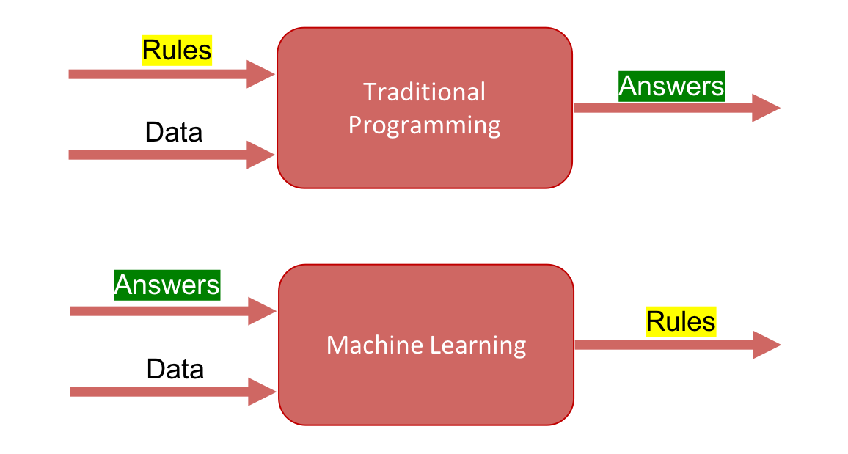
What is Machine Learning?
Source

Slide 6


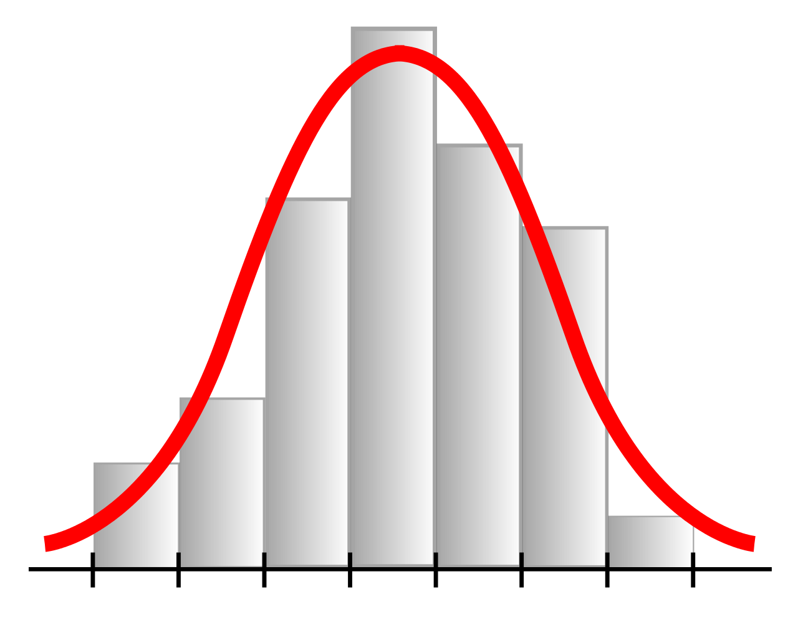
A map of Data Science
No decisions
Few decisions
Many decisions
Descriptive analytics
Statistics
Machine Learning

Slide 7
Types of Machine Learning

Slide 8

Types of Machine Learning
Source

Slide 9
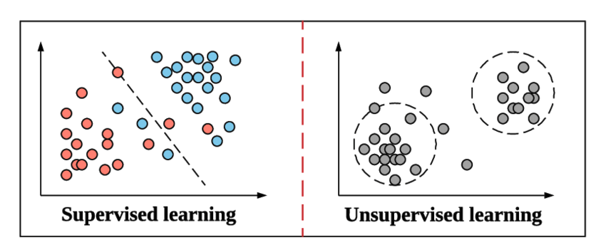
Supervised Learning
Supervised Learning is the majority of machine learning problems today
We have an input X and an output y, and we try to find the mapping between them
Essentially we have the “correct answer” for the feature vector X and try to construct a model that can make this distinction in future paradigms
Fraud Detection
Face Recognition
Predictive Maintenance
Language Translation
Medical Diagnostics
Speech Recognition
Source

Slide 10

Supervised Learning: types
There are two kinds of supervised learning: Classification and Regression.
In Classification, we ask which (class) and in the Regression how much
Source

Slide 11
Supervised Learning: Algorithms
Classification:
If a shopkeeper wants to predict that a particular customer will come back to his shop or not, he will use a classification algorithm. Examples of classification algorithms include:
Decision tree
Naïve Bayes
Random forest
Logistic regression
K-nearest neighbor (KNN)
Regression:
This method is used when the predicted data is numerical.
If the shopkeeper wants to predict the price of a product based on its demand, he will choose regression.
Linear Regression
Polynomial Regression
Fraud Detection

Slide 12
Unsupervised Learning
In unsupervised learning, we don't have labels for the features X
The model is trying to find the underlying distribution of the data in order to learn more about the data (correlation, groups, etc)
Market Basket Analysis
Recommender Systems
Data Exploration and Visualization
Anomaly Detection
Customer Segmentation
Source

Slide 13
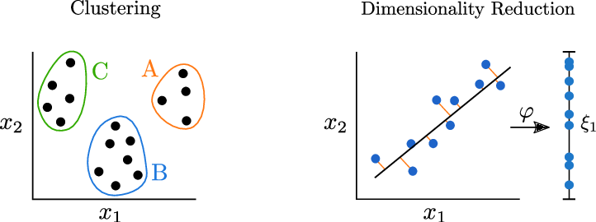
Unsupervised Learning: types
For clustering, points with high similarity (i.e. near each other) are grouped together in clusters to identify patterns in data.
The field of dimensionality reduction tries to transfer high-dimensional data into efficient low-dimensional representations by finding appropriate transformations ϕ, like PCA.
Customer Segmentation

Slide 14
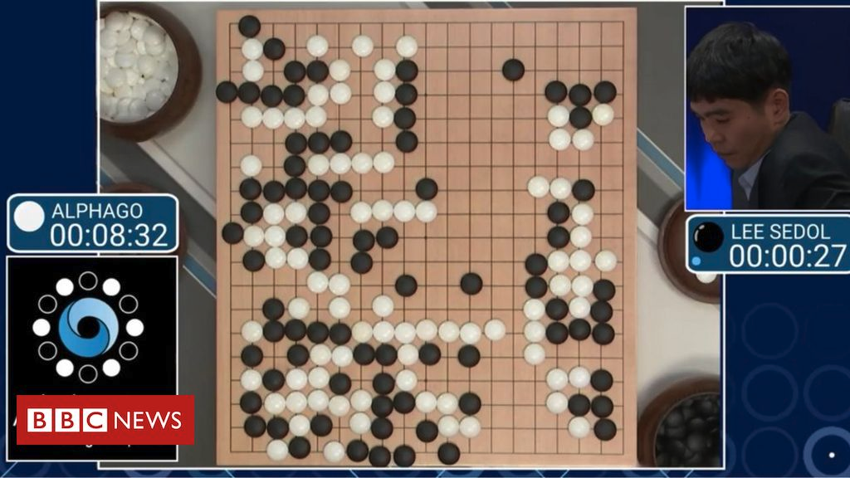
Reinforcement Learning
The system learns from its mistakes and experiences in a closed environment with rules
The agent is exploring an environment and tries to maximize a reward function
It is a powerful technique because it doesn't need a dataset with labels, it needs only a simulation environment
Vision
Robotics
Self-driving cars
Games
Source
Video

Slide 15
Machine Learning Pipelines

Slide 16
Machine Learning Typical Pipeline
Collect Data
Train model
Train Set
Model
Prepare / Clean Data
Split
Train / Test
Model
Evaluation
Test Set
Iterate until we find best model

Slide 17
Making predictions on new data
New Data
Data Preparation
Model
Predictions

Slide 18
Random Splitting
Split the data into Training and Test
Training
Data
Train
Model
DATA
DATA
Random
Splitting
Test
Data
Evaluate
Model

Slide 19
Bias - Variance tradeoff

Slide 20
Bias - Variance tradeoff
Bias: The difference between the average prediction of the model and the real value, high bias means the model “doesn’t pay” attention to the dataset and is oversimplified, leads to high error rates in the training and the test set
Variance: The ability of the model to generalize, models with high variance “pay a lot” of attention to the training set and does not generalize well to unseen data (high error on test set)
So it is important to find a tradeoff between these 2 variables!

Slide 21
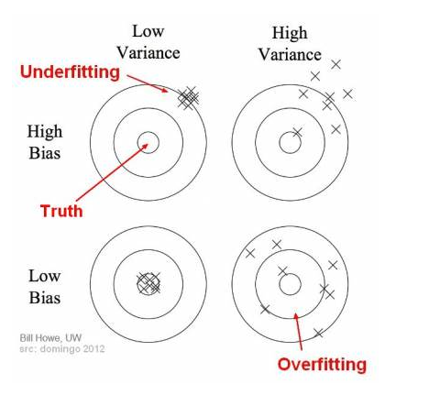
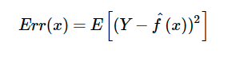
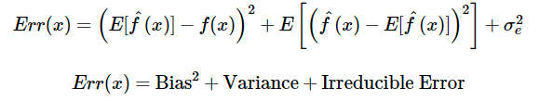
Bias - Variance tradeoff
Suppose we have Y=f(X) + e, the expected square error is:
By expanding the equation, we get:
Source

Slide 22
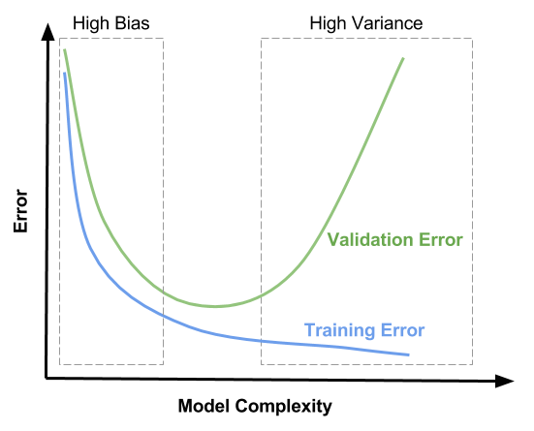
Bias - Variance tradeoff
If our model is too simple and has very few parameters then it may have high bias and low variance
If our model has large number of parameters then it’s going to have high variance and low bias
So we need to find the right balance without overfitting and underfitting the data
Source

Slide 23
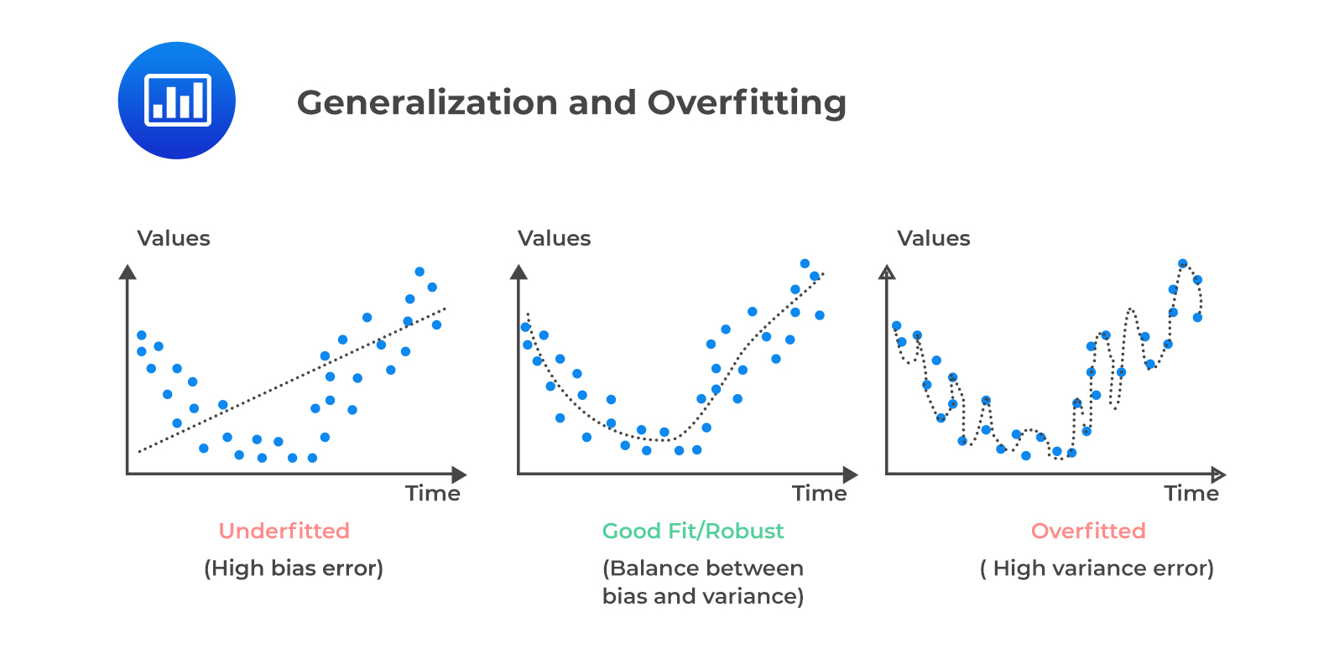
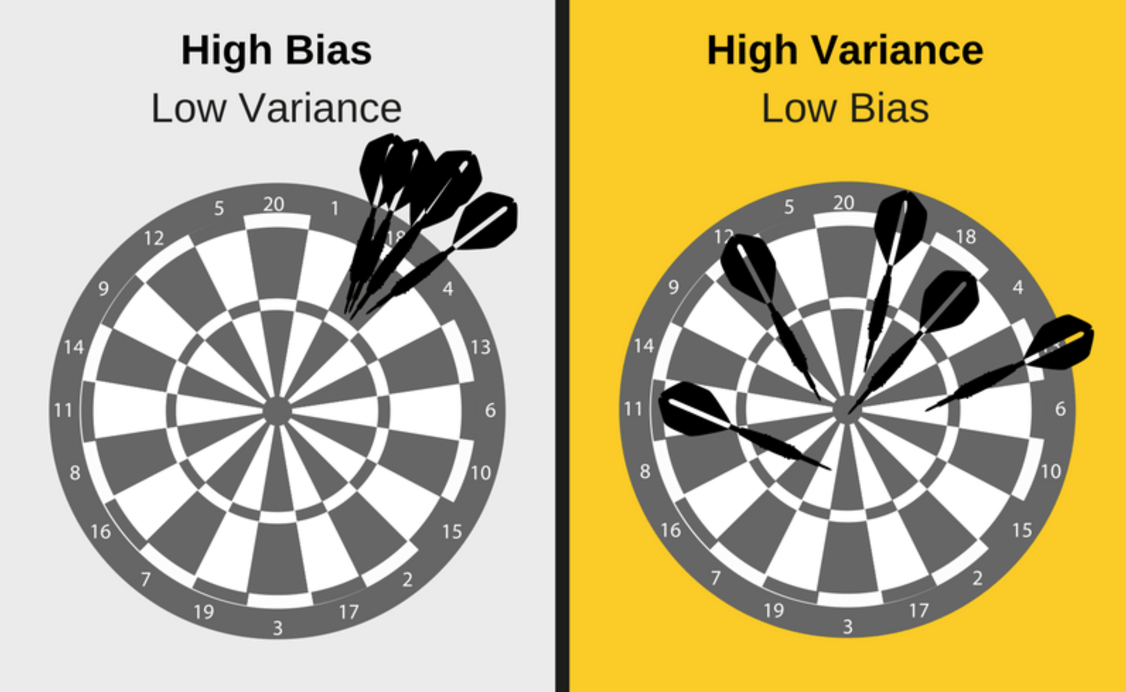
Underfitting example
Happens when the model can't capture the underlying pattern in the data (high bias - low variance)
It happens when we don't have enough data for the model to train to
When we build a linear model to capture non-linear data
Source

Slide 24
Overfitting example
Overfit happens when we have low bias - high variance
The model captures the noise along with the data
When a model is too complex for the data, it is prone to overfitting (e.g., Neural Networks)
Source

Slide 25

Good fit example
Low Bias / Low Variance

Slide 26
Cross Validation

Slide 27
Cross Validation
Cross-validation is a statistical method used to estimate the performance of machine learning models. It is used to protect against overfitting in a predictive model, particularly in a case where the amount of data may be limited.
It has two main steps: splitting the data into subsets (called folds) and rotating the training and validation among them. The splitting technique commonly has the following properties:
Each fold has approximately the same size.
Data can be randomly selected in each fold or stratified.
All folds are used to train the model except one, which is used for validation. That validation fold should be rotated until all folds have become a validation fold once and only once.
Each example is recommended to be contained in one and only one fold.

Slide 28
Cross Validation (k-fold)
Validation
Train
Select best model after cross validation
1)
2)
Model
One part for train & validation
CV
Data
DATA
3)
4)
Splitting
5)
One part for test
Evaluate
Model
Test
Data
Test data is used, after we optimize the model

Slide 29
Optimization

Slide 30
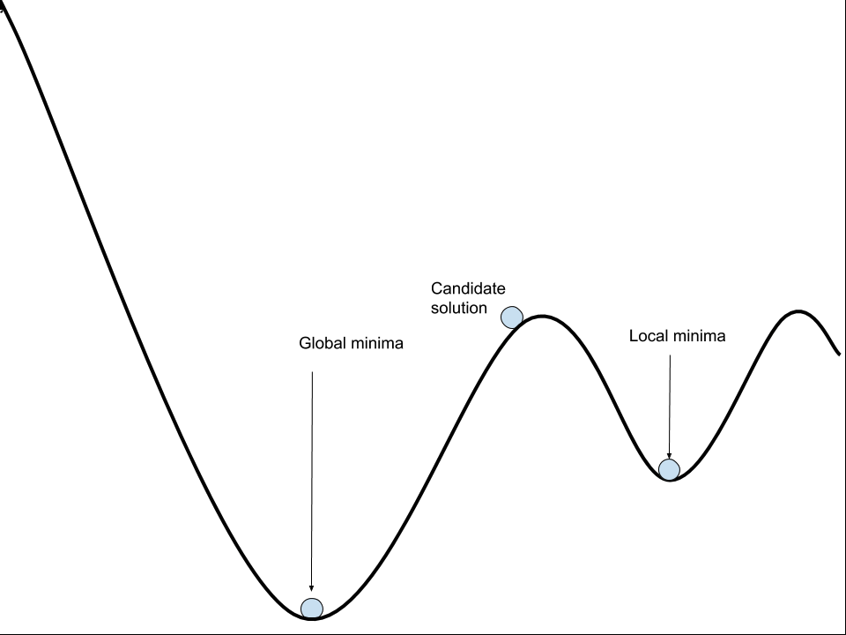
What is optimization ?
Optimization is the process of finding the global minima of a function through an iterative method.
To achieve that, you calculate the gradient and take a step in the direction that the gradient points “down”
Source
Notes:
Maybe put math here ?
Βελτιστοποίηση = optimization
Επαναληπτικών = iterative
Κατάβασης Δυναμικού
τοπικά ελάχιστα
(κάθοδος βασισμένη στην κλίση

Slide 31
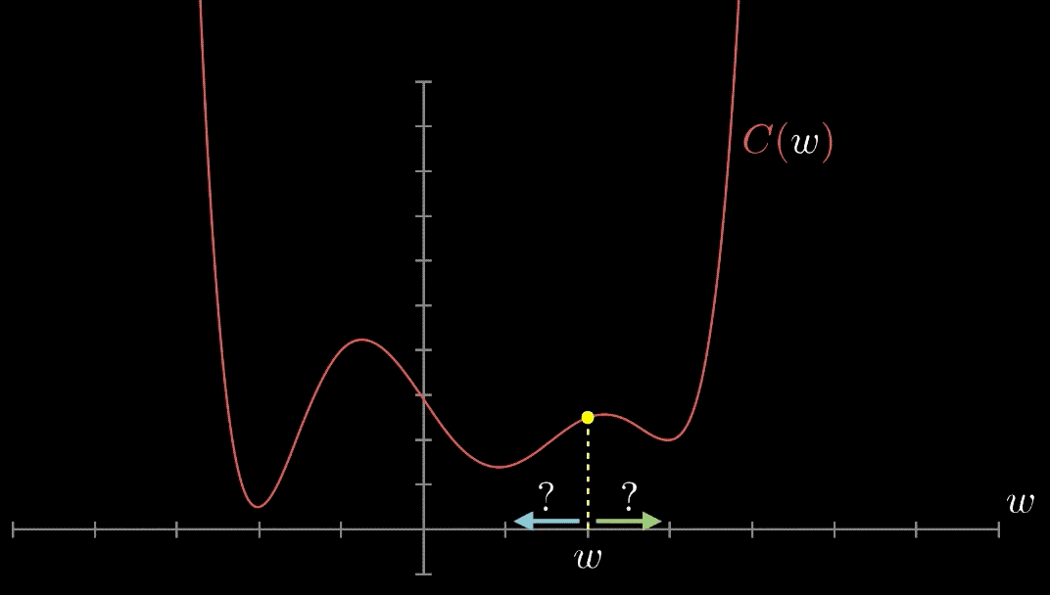
Find the local minimum
Source
Notes:
X αξωνας
Παράγωγο συναρτησης

Slide 32
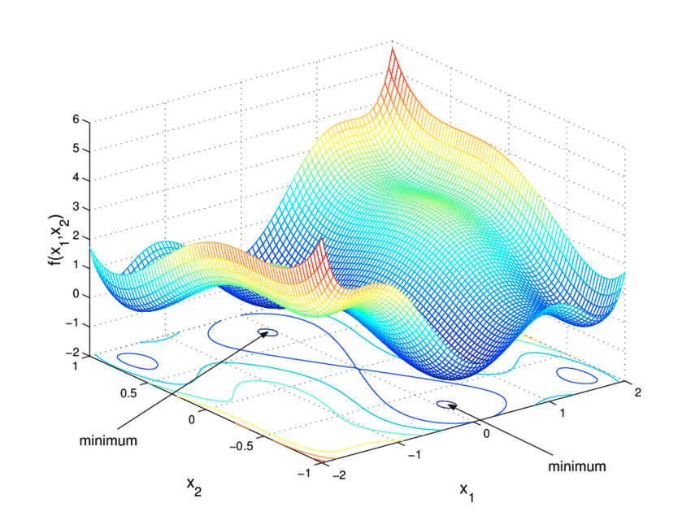
Not all functions are 2D
Most of the time, we don’t have 2D functions that we can calculate the minima with analytic solutions.
But we have complex functions and finding the global minima can be quite complex.
Source

Slide 33
Goal: minimizing the loss/cost function
Given a known set of inputs and their corresponding outputs, a machine learning model tries to make predictions for a new set of input(s).
Machine Learning Model
Y
Actual Output
x
Y’
Predicted Output
The Error would be the difference between the two predictions
Error = Y’(Predicted) - Y(Actual) + a * Sum |bi|
The Loss/Cost function computes the error for a single training example: basically tells us how good our model is at making predictions for a given value of m and b in Y = mX + b where m is the slope and b is its intercept on the Y-axis.
Source
Notes:
Συναρτηση κοστους

Slide 34
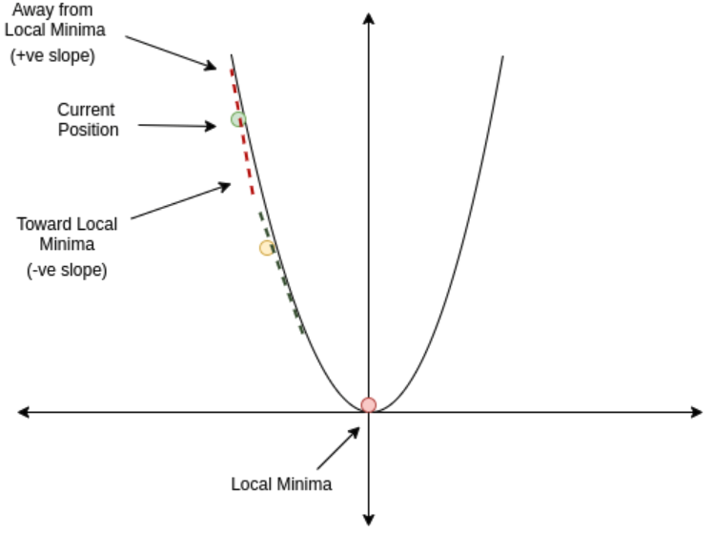
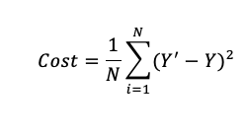
Minimizing the cost function
In the case we take the MSE, our cost function is a parabola
Away from Global Minima
Toward Global Minima
So by calculating the gradient we want to move close to the local minima
The process of finding the local minima, it is called training our model
Global Minima
Source

Slide 35
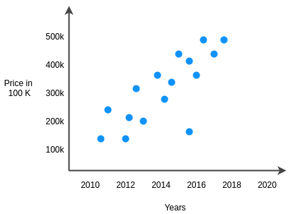
Gradient Descent
Gradient descent is the optimization algorithm that we use to find the parameters of a model
Model
Source
Notes:
κάθοδος βασισμένη στην κλίση
γραμμικής παλινδρόμησης

Slide 36
Types of Gradient Descent
Batch Gradient Descent: It processes all training examples in each epoch and in the end take the average gradient to update the parameters
Pros:
Stable convergence + more computationally efficient
Cons:
Can get stuck at local minima
Stochastic Gradient Descent : It processes one training example in each iteration and updates the parameters
Pros:
Can have faster convergence
Cons:
Computationally intensive and noisy gradients
Mini batch Gradient Descent: It splits the dataset into mini batches, and it calculates the gradient in each mini batch. Best of both worlds!

Slide 37
Learning Rate
Learning rate is how big the step will be in one direction.
Learning rate is a hyperparameter, meaning that we have to choose the value.
Too small learning rate, and the optimization will take forever
Too big learning rate and we might miss the minima
Learning Rate
Notes:
βήμα εκπαίδευσης

Slide 38

Too small learning rate
Source

Slide 39
When to Stop training
There are 3 conditions that gradient descent uses to stop
maxiter: When it reaches the maximum number of iterations
reltol: When the improvement drops below a threshold
abstol: When the function gets close enough to zero

Slide 40
Data Transformations

Slide 41
Types of Transformations
The following are used interchangeably, but they are not the same
Normalization: Is when you scale in respect to all the data range to [0,1] (Min-Max)
Standardization: Is when you transform in respect to all the data range so that the data has a mean of 0 and a standard deviation of 1
Transformation: It transforms each data point with the same transformation separately

Slide 42
Scaling
Scaling our data is essential for 2 reasons:
Same size scale
Mathematical libraries perform faster in the [-1,1] or [0,1]
There are different types of scaling each one with benefits in certain problems

Slide 43
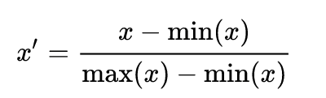
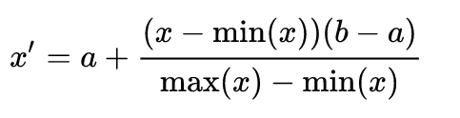
Min-Max Scaling
Scales the data between [0,1] or more generally between [a,b]
Normalization (Min-Max) is good to use when you know that the distribution of your data does not follow a Gaussian distribution. This can be useful in algorithms that do not assume any distribution of the data like K-Nearest Neighbors and Neural Networks.
Source

Slide 44
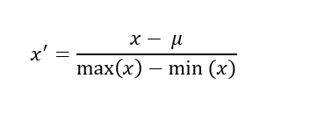
Mean Normalization
It it used when we want our data to have zero mean. What it does is that it calculates and subtracts the mean for every feature. A common practice is also to divide this value by the range or the standard deviation.
Source

Slide 45
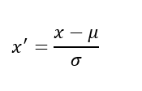
Z-score normalization
When the same process is done and the standard deviation is used as the denominator then this process is called Standardization. In this normalization we subtract the mean and divide by the standard deviation, this is a common regularization used in SVM’s, Neural Networks, Logistic Regression
Z-score normalization refers to the process of normalizing every value in a dataset such that the mean of all of the values is 0 and the standard deviation is 1.
We use it in cases where the data follows a Gaussian distribution. However, this does not have to be necessarily true. Also, unlike normalization, standardization does not have a bounding range. So, even if you have outliers in your data, they will not be affected by standardization.
Source

Slide 46
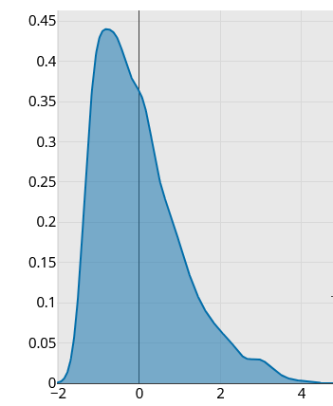
Simple Transformations: Right Skewed
When the data is right skewed there are 3 commonly used transformations, listed from weakest to strongest
Choosing a transformation depends on the degree of skewness in the data
ⁿ√x: Highest the root order, stronger the transformation, be careful of negative numbers
log(x): Commonly used transformation, be careful again with negative numbers and zero
1/x: Stronger transformation, by increasing the power of the denominator it becomes even stronger, be careful with numbers close to zero
Source
Notes:
In log and 1/x usually you shift the data bey |min(x)| + 1

Slide 47
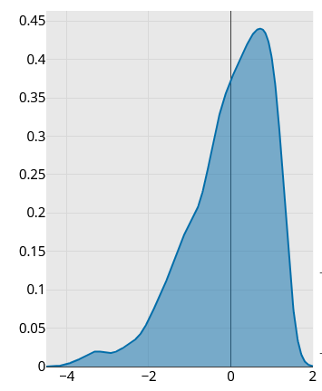
Simple Transformations: Left Skewed
The opposite of the situation discussed above, hence you apply the “opposite” operations
Shift the data to be right skewed and apply the previous operations
x²: String operation, that becomes stronger with higher the power, cannot be used with negative values
eˣ: Strongest operation, and becomes stronger with higher base and also can be used with negative numbers
Source

Slide 48
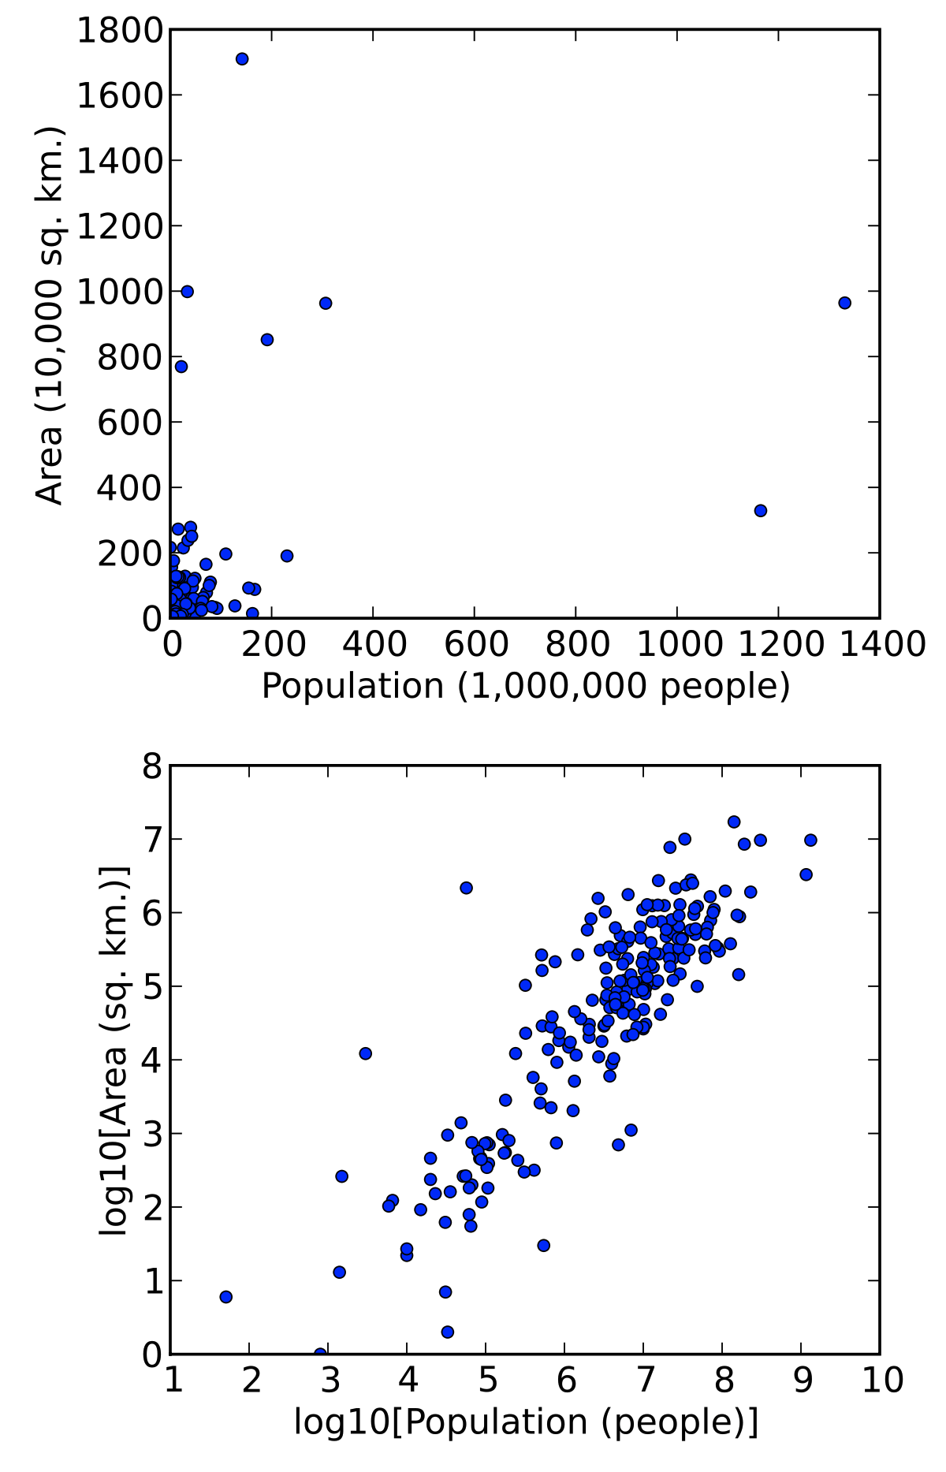
Transformation: Logarithmic
Sometimes the relationship between our data is shown clearly when we transform it in a different space
Source

Slide 49
Avoiding Data Leakage
If you scale your data before splitting it into training/testing sets, the "Mean" and "Max" values from the test set "leak" into your training process, giving you false confidence.
The Mistake: Applying transformations (like Min-Max Scaling ) to the entire dataset before splitting it.
The Consequence: The model "sees" information from the test set (e.g., the global maximum value) during training.
Source

Slide 50
Classification Performance Metrics

Slide 51
Metrics
There are a lot of metrics that we can use, each one has different properties that we can use in different problems e.g.:
Imbalanced classes
Minimizing False positive or False Negative

Slide 52
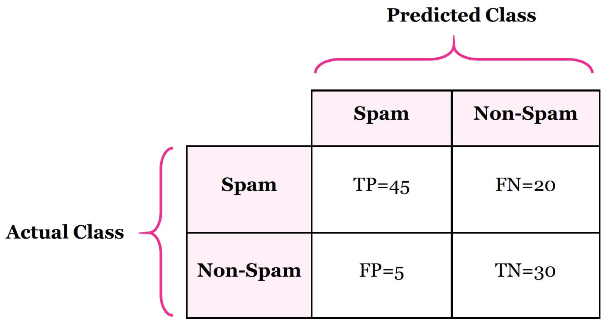
Metrics Visualized: confusion matrix
We want them low
We want them high
It is often used to describe the performance of a classification model on a set of test data for which the true values are known
In general, you want a high number of TP and TN and a low number of FP and FN
Source

Slide 53
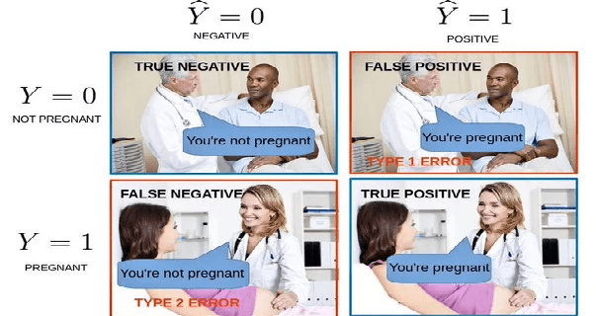
Metrics Visualized
True Positive (TP)
The predicted value matches the actual value
The actual value was positive and the model predicted a positive value
True Negative (TN)
The predicted value matches the actual value
The actual value was negative and the model predicted a negative value
False Positive (FP) – Type 1 error
The predicted value was falsely predicted
The actual value was negative but the model predicted a positive value - Also known as the Type 1 error
False Negative (FN) – Type 2 error
The predicted value was falsely predicted
The actual value was positive but the model predicted a negative value - Also known as the Type 2 error

Slide 54
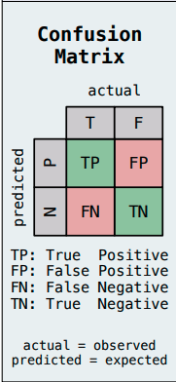
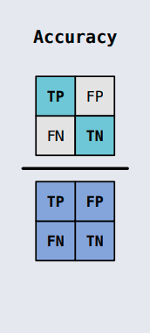
Metrics Visualized: Accuracy
Accuracy: Measures the percentage of the correctly classified instances
Careful: Accuracy does not measure the misclassification error (False Positive and False Negatives)
So when the dataset is imbalanced accuracy may be misleading
Source

Slide 55
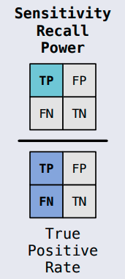
Metrics Visualized: Recall
Recall: also known as the true positive rate (TPR), is the percentage of data samples that a machine learning model correctly identifies as belonging to a class of interest—the “positive class”—out of the total samples for that class.

Slide 56
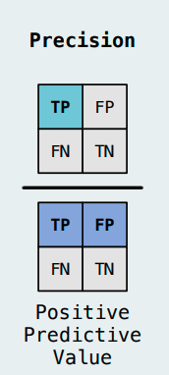
Metrics Visualized: Precision
Precision: Measures is a metric that measures how often a machine learning model correctly predicts the positive class. You can calculate precision by dividing the number of correct positive predictions (true positives) by the total number of instances the model predicted as positive (both true and false positives).

Slide 57
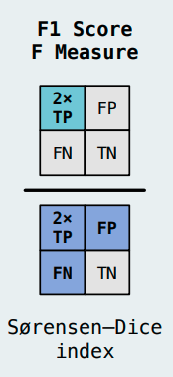
Metrics Visualized: F1 Score
F1 Score: The harmonic mean of precision and recall

Slide 58
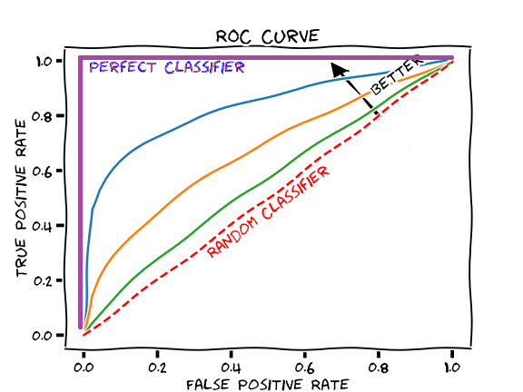
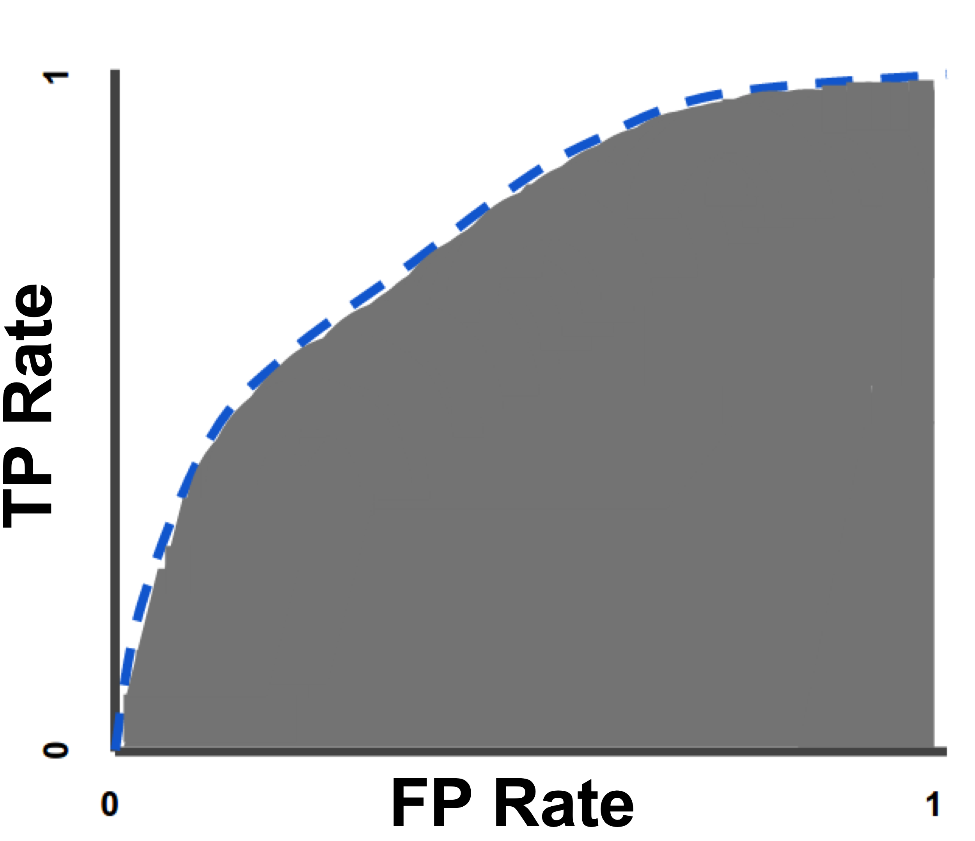
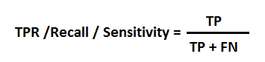
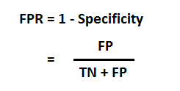
ROC and AUC
ROC(Receiver Operator Characteristic ) is the TPR against the FPR
AUC (Area Under the Curve) measures the probability that our classifier makes a correct prediction
The dotted line denotes that the prediction is random(AUC=0.5)
The closest to 1 means our classifier is getting better
AUC is a great metric to compare classifiers between them
AUC is the area below each curve. The larger the area the better the model
AUC

Slide 59
Imbalanced datasets

Slide 60
Handling imbalanced datasets
The Problem with the Accuracy metric
Use training dataset to train the model
DATA
Training
Data
Split the data into Training and Test
Biased
Model
Imbalanced Dataset
DATA
Test the Model
Banana
Evaluate
Model
Test
Data
Apple
Apple
The model will mostly predict a banana!
Banana

Slide 61
Metrics for imbalanced datasets
Confusion Matrix
Precision
Recall
F1 Score

Slide 62
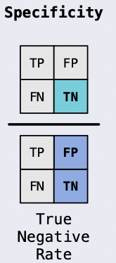
Balanced Accuracy
Balanced accuracy is a metric that one can use when evaluating how good a binary classifier is.
It is useful when the classes are imbalanced, i.e. one of the two classes appears a lot more often than the other
Balanced accuracy is based on two more commonly used metrics: sensitivity and specificity
Balanced accuracy attempts to account for the imbalance in classes
+
2

Slide 63
Resampling Techniques - Undersample majority class
We match the number of samples in the minority class with a random sample from the majority class
DATA
Undersampled Dataset
Undersampling can be a good choice when you have a lot of data.
A drawback is that we are removing information that may be valuable.
This could lead to underfitting and poor generalization to the test set.
Banana
Imbalanced Dataset
Banana
Apple
Apple

Slide 64
Resampling Techniques — Oversample minority class
We match the number of samples in the majority class with resampling from the minority class. We randomly replicate samples from the minority class.
Oversampled Dataset
Always split into test and train sets BEFORE trying oversampling techniques!
Oversampling before splitting the data can allow the exact same observations to be present in both the test and train sets.
This can allow our model to simply memorize specific data points and cause overfitting and poor generalization to the test data.
DATA
Banana
Banana
Imbalanced Dataset
Apple
Apple
Apple

Slide 65
Imputation

Slide 66
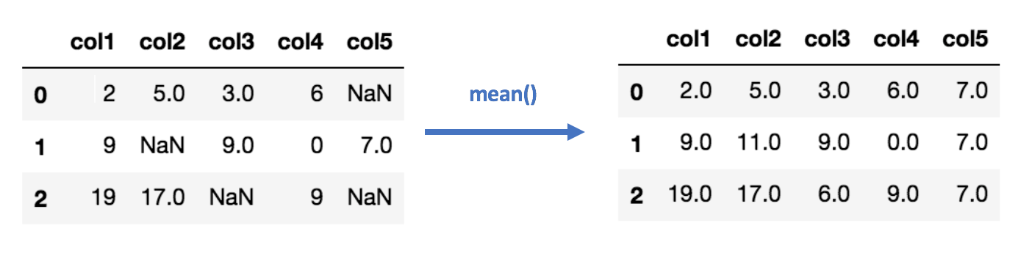
Imputation - Continuous Features: Mean/Median
We calculate the mean/median of the non-missing values in a column and then replace the missing values within each column separately and independently from the others.
Pros:
Easy and fast.
Works well with small numerical datasets.
Cons:
Doesn’t factor the correlations between features. It only works on the column level.
Not recommended for categorical features
Not very accurate.
Doesn’t account for the uncertainty in the imputations.
Source

Slide 67
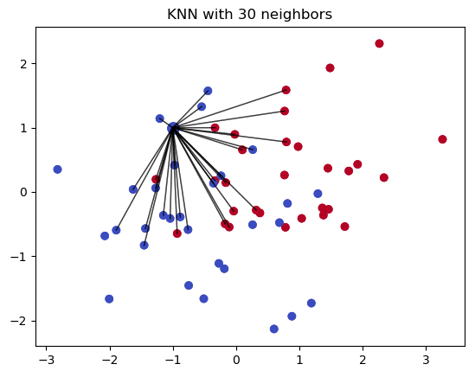
Imputation: using k-NN
The algorithm uses ‘feature similarity’ to predict the values of any new data points. This means that the new point is assigned a value based on how closely it resembles the points in the training set.
It creates a basic mean impute then uses the resulting complete column to construct a KDTree.
It uses the resulting KDTree to compute nearest neighbours.
After it finds the k-NNs, it takes the weighted average of them.
Can be much more accurate than the mean, median or most frequent imputation methods
Computationally expensive. KNN works by storing the whole training dataset in memory
K-NN is quite sensitive to outliers in the data
Source

Slide 68
Improving model performance

Slide 69
Hyperparameter Tuning (HT)
Hyperparameter tuning is the task of choosing the right parameter values for a machine learning algorithm
Hyperparameters are set prior to training and choosing the right ones can influence the performance of the model
Some common hyperparameters are:
Learning Rate
Number of Neighbours
Penalty

Slide 70
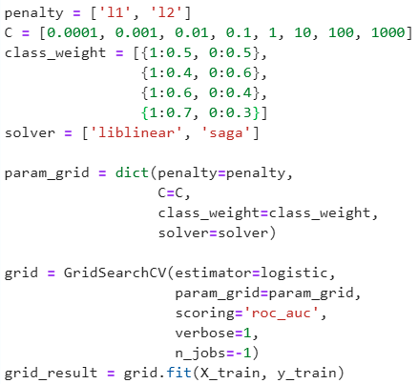
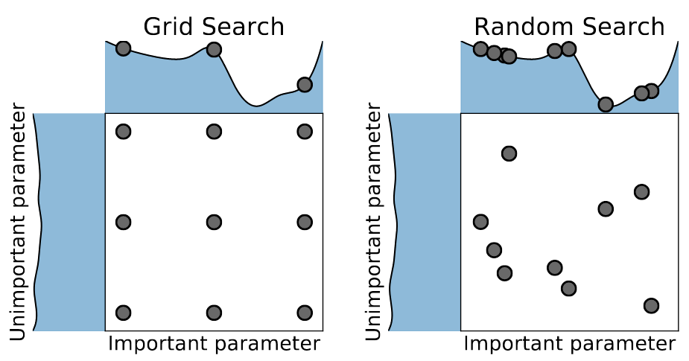
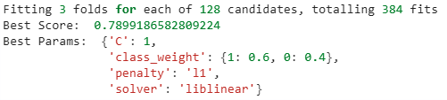
HT: Grid Search
Grid Search is exhaustive search in the hyperparameters of a model
Using CV for each subset of hyperparameter we get the best set as a result
With GridSearch we always find the best set of hyperparameters from the ones we are testing
Because of the exhaustive search it is very computationally expensive and time consuming

Slide 71
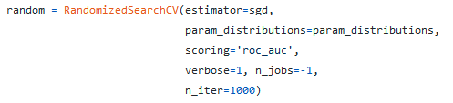
HT: Random Search
Random Search tries to tackle the large computation time of Grid Search
We search randomly instead of exhaustively
The pro’s in the decreased training times the cons is we don't know that they are the optimal set of hyperparameters
We have to define the number of combinations that random search will try
Number of iterations
The hyperparameters values from the Random search tend to have similar performance as the ones from Grid Search

Slide 72
Quiz time

Slide 73
When to scale?
Α). Before the splitting
Β). After the splitting
C). Doesn’t matter
Notes:
Upsampling should be done after splitting the data into training and testing sets to avoid data leakage. If you upsample before splitting, information from the test set could inadvertently influence the training set, leading to overly optimistic performance metrics and reduced generalizability.
By upsampling after the split, you ensure that the test set remains a true representation of the real-world data distribution, allowing for a more accurate evaluation of the model's performance.

Slide 74
When to upsample?
Α). Before the splitting
Β). After the splitting
C). Doesn’t matter
Notes:
Upsampling should be done after splitting the data into training and testing sets to avoid data leakage. If you upsample before splitting, information from the test set could inadvertently influence the training set, leading to overly optimistic performance metrics and reduced generalizability.
By upsampling after the split, you ensure that the test set remains a true representation of the real-world data distribution, allowing for a more accurate evaluation of the model's performance.

Slide 75
When to downsample?
A). Before the splitting
B). After the splitting
C). Doesn’t matter
Notes:
Downsampling should be done after splitting the data into training and testing sets to avoid data leakage. If you downsample before splitting, information from the test set could inadvertently influence the training set, leading to overly optimistic performance metrics and reduced generalizability.
By downsampling after the split, you ensure that the test set remains a true representation of the real-world data distribution, allowing for a more accurate evaluation of the model's performance.

Slide 76
When to impute?
A). Before the splitting
B). After the splitting
C). Doesn’t matter
Notes:
Imputation should generally be done before splitting the data into training and testing sets. The reason is that missing values in your dataset are part of the natural distribution of your data, and handling them before splitting ensures consistency across both training and testing sets.

Slide 77
When to create dummies?
A). Before the splitting
B). After the splitting
C). Doesn’t matter
Notes:
Creating dummy variables (one-hot encoding) is typically done before splitting the data into training and testing sets to ensure that both sets have the same feature structure. If you create dummies after splitting, there's a risk that some categories present in the training set might not appear in the test set (or vice versa), which can lead to mismatched feature columns and errors during model training or evaluation

Slide 78
When to create new features?
A). Before the splitting
B). After the splitting
C). Doesn’t matter
Notes:
New feature creation should generally be done before splitting the data. Creating features based on existing data before splitting ensures that the same transformations apply consistently to both the training and test sets. This way, both sets have the same feature space and are comparable during model training and evaluation.

Slide 79
Thank you!

